Slide 1
RTL DESIGN OF DMA CONTROLLER

Slide 2
Team Members:
Pratik Avinash Narkhede
Tanmay Nitin Patil
Abdul Hasan Imroze Mohammed

Slide 3
AGENDA:
Introduction to DMA Controller.
Working of DMA Controller.
High Level Design Architecture.
High Level DMA Design.
Priority Logic.
Data Path Logic.
Timing and Control Logic.
SystemVerilog Constructs Used.
Integration Hierarchy.
Verification.
Challenges Faced and Edification.
Future Scope.
References.

Slide 4
Introduction to DMA Controller:
Direct Memory Access is a hardware device, which has a distinctive attribute in the system, which allow some of the hardware subsystem to access the main memory irrespective or independent of the Central Processing Unit (CPU).
The main objective of the DMA Controller is to enhance the system performance by directly data from I/O device to the main memory through DMA Controller without the interference of the CPU.

Slide 5
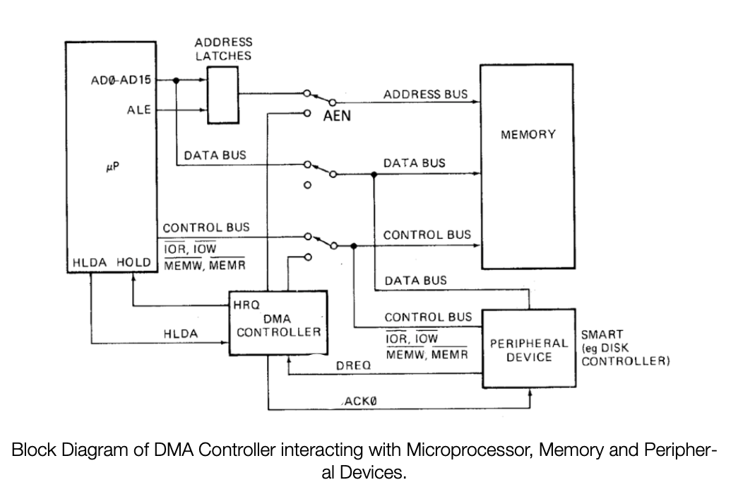
Working Of DMA Controller:

Slide 6
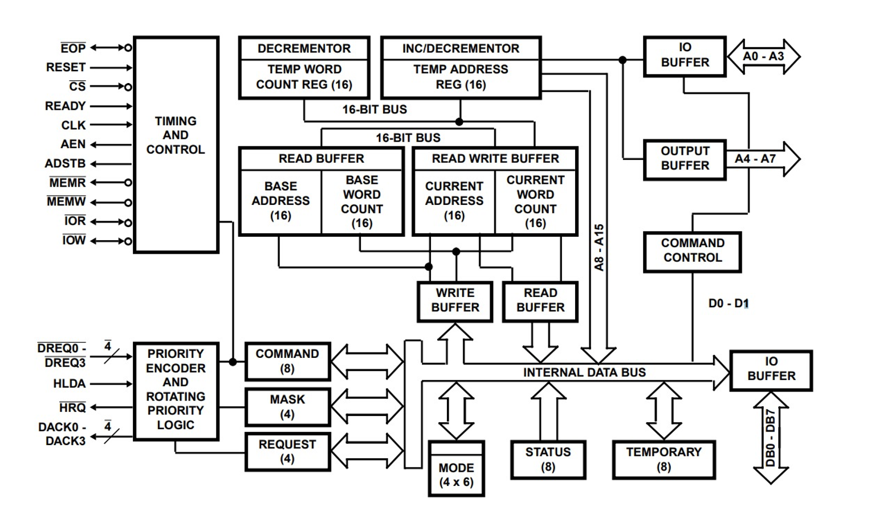
Working Of DMA Controller:(Continuation)

Slide 7
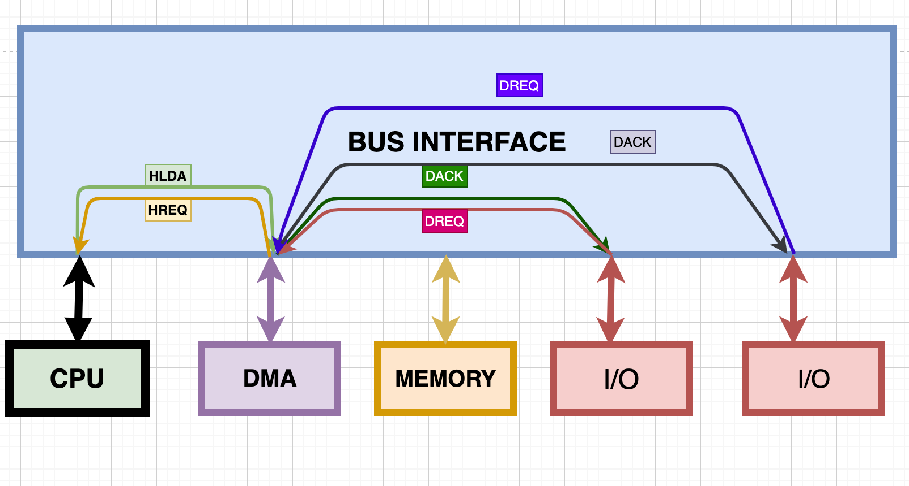
High Level Design Architecture:

Slide 8
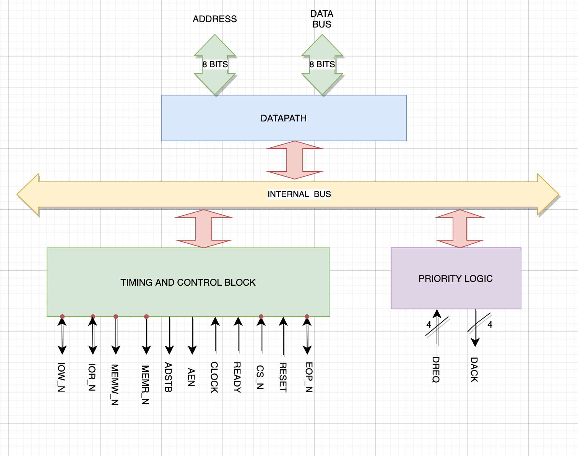
High Level DMA Design:

Slide 9
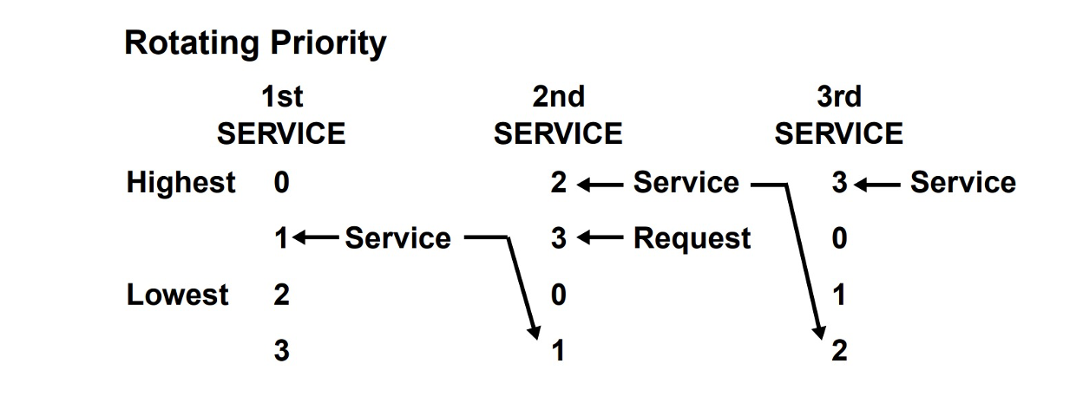
Priority Logic:
The 8237A DMA Controller has to types of priority logic.
Fixed Priority: Every I/O device has an unique rank. Channels are given fixed priority based on the descending value of their number.
Rotating Priority: The Last channel to get acknowledgement gets the lowest priority with others rotating accordingly.

Slide 10
Data Path Logic:
Handles all the Internal Registers of the DMA.
In ideal cycle Command Register, Mode Register, Base Address Register, Base Word Count Register, Current Address Register, Current Word Count Registers are programmed.
Increments the Address Register, decrements the word count, updates the status register in the active cycle.
Makes the internal flip flop to a known state to read/write the address/word count register.

Slide 11
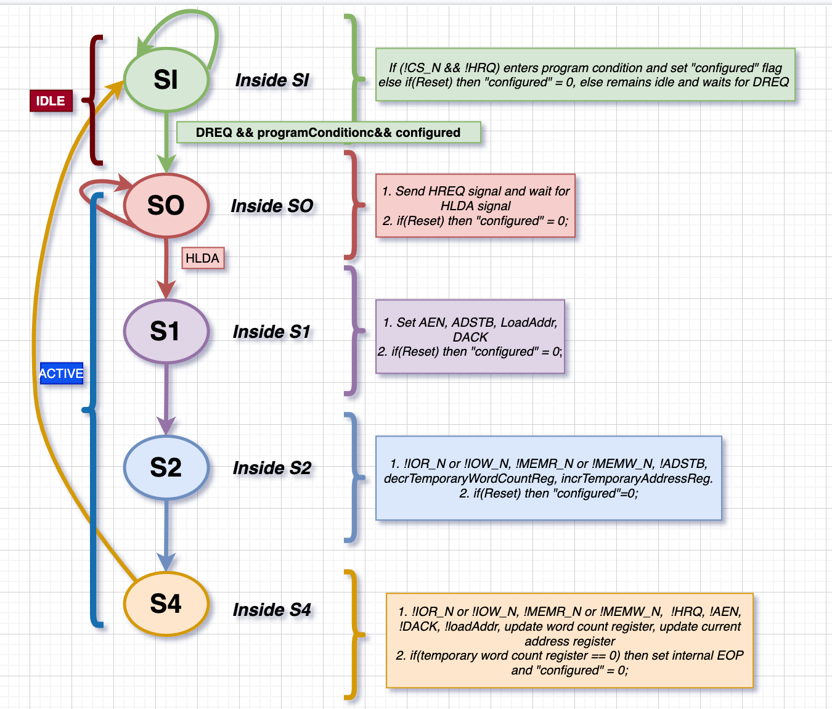
Timing and Control Logic:

Slide 12
SystemVerilog Constructs Used:
Assertions
Interfaces
Package
Priority Case and Unique Case
Structures
Enumerated types

Slide 13
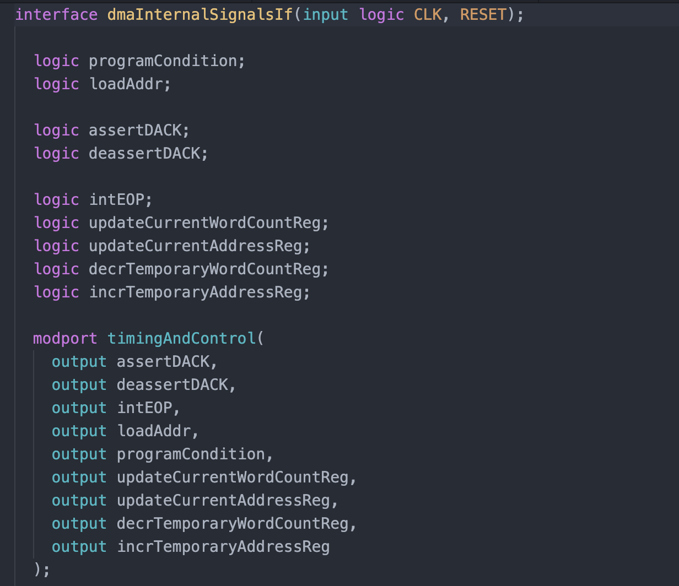
Interface Construct:

Slide 14
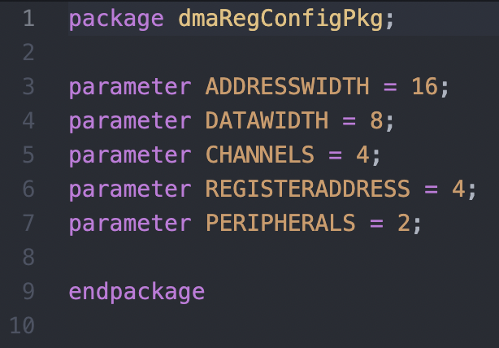
Package Construct:

Slide 15
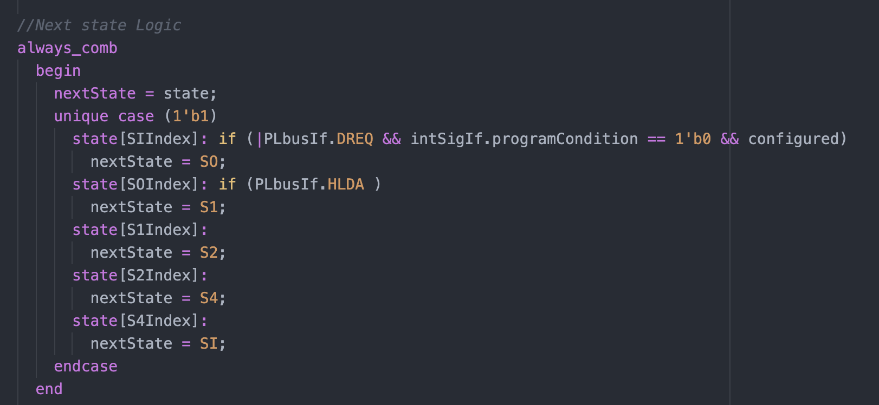
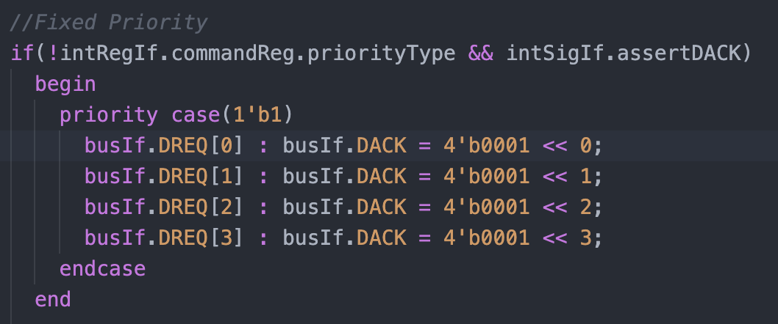
Priority Case and Unique Case Construct:

Slide 16
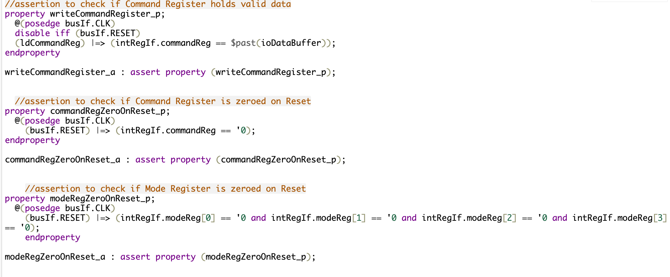
Assertions Construct:

Slide 17
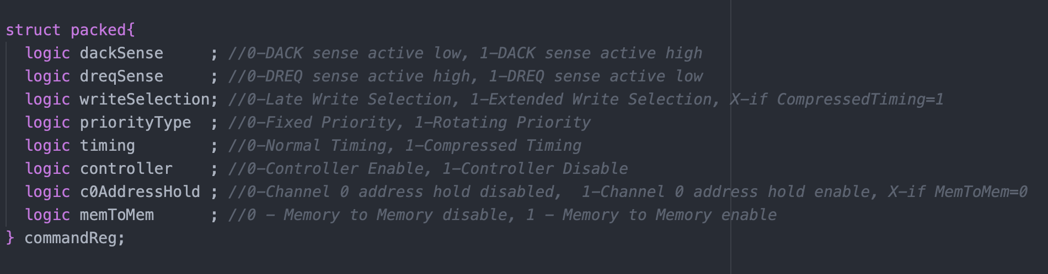
Structure Construct:

Slide 18
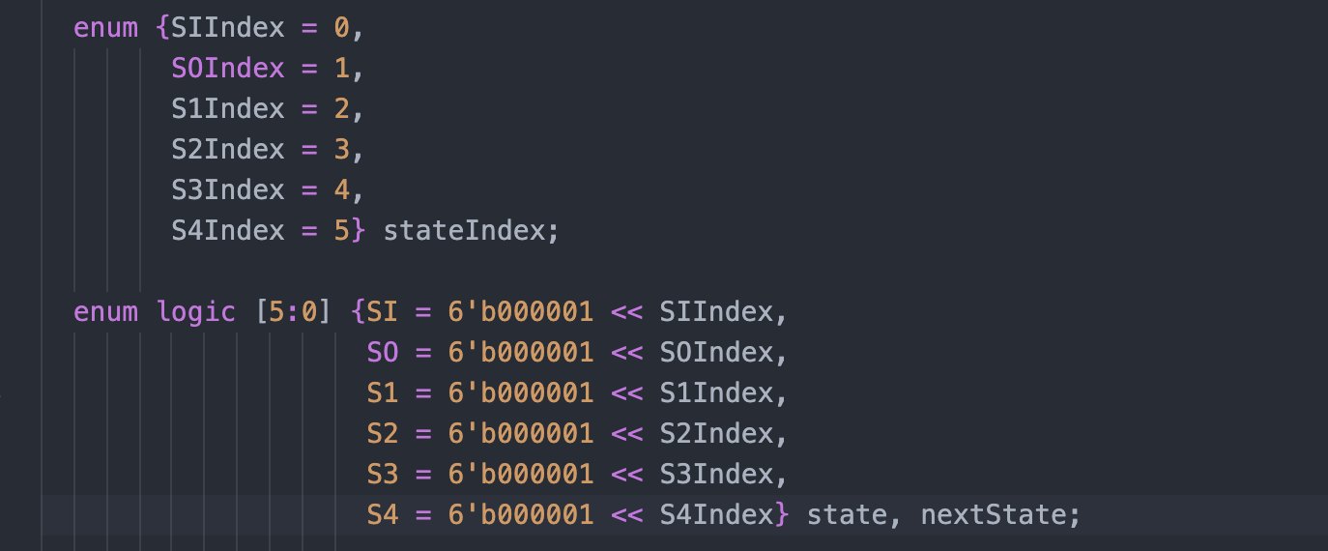
Enumerated Types Construct:

Slide 19
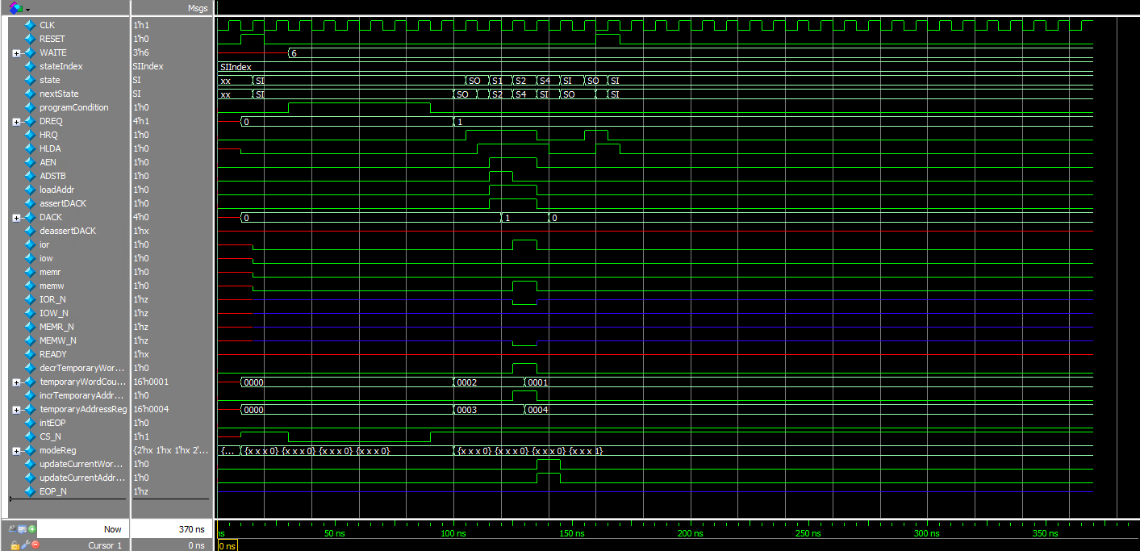
Integration Hierarchy:
Timing and Control FSM waveform

Slide 20
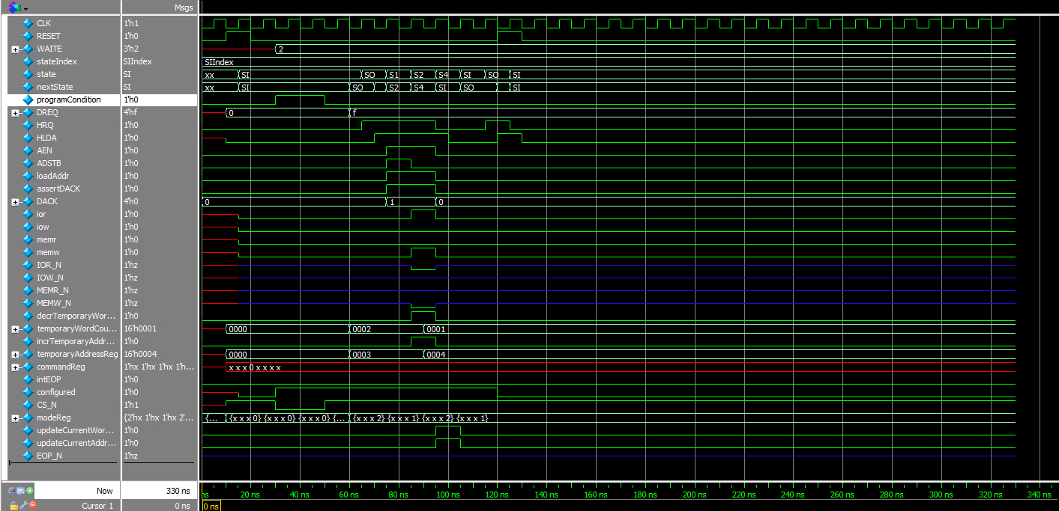
Integration Hierarchy:
Priority Logic and Timing and Control Integration Waveform.

Slide 21
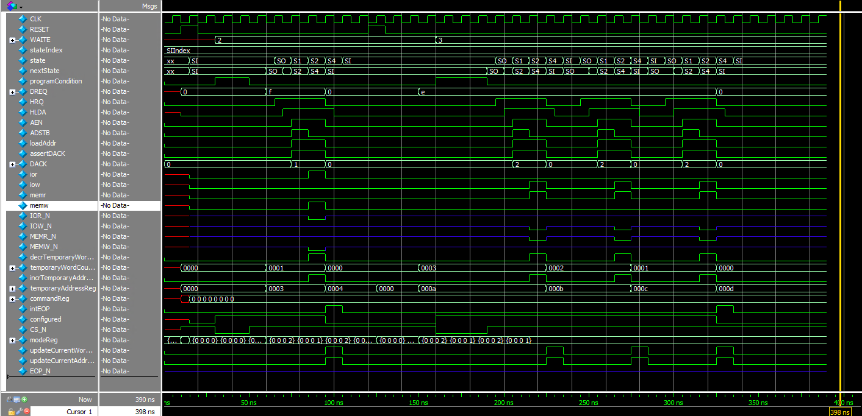
Integration Hierarchy:
Independent DMA waveform.

Slide 22
Verification:
Unit Level Testing:
Priority Logic: Applied directed test cases.
Timing and Control Logic: Applied directed test cases.
Datapath Logic: Applied directed test cases.
Used assertions.
Used bottom-up approach to test the design.
System Level Testing:
Applied directed test cases at the system level.
Debugging was done mostly with the help of printing $display, waveforms and error messages.

Slide 23
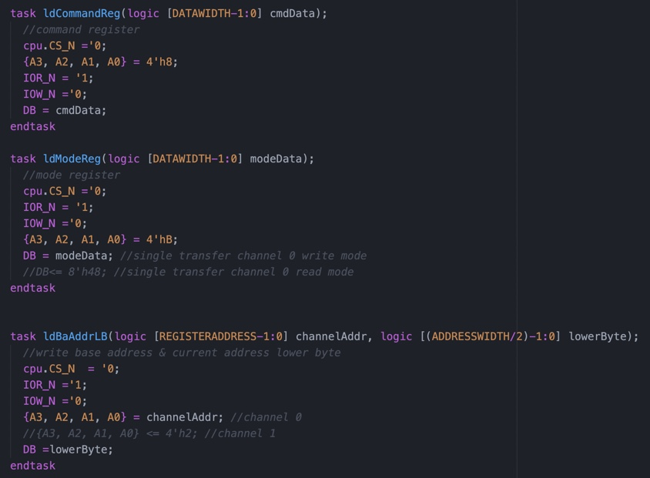
Task Used for Register Configuration:

Slide 24
Challenges Faced and Edification:
System level Integration and environmental integration took a lot of time debugging simulation time errors.
Comprehension of the data sheet for correct implementation of the design
Modelling Bi-directional Signals.
Identifying issues in the design with aid of test bench.

Slide 25
Future Scope and Intent:
Run Back-end simulation, work on the design from synthesis to GDSII.
Assertion Based Verifications.
Improve the design to support Block Transfer Mode, Demand Transfer and Cascade transfer mode.

Slide 26
Source Code:
Github Link.

Slide 27
References:
8237 Data Sheet(Intel).
ECE 585 Basic I/O Lecture Slides.
Direct Memory Access - (Wikipedia).
Round Robin Arbitration source-1.
Round Robin Arbitration source-2.

